Slide 1

Brain Tumours in Scotland
Peter Menzies

Slide 2
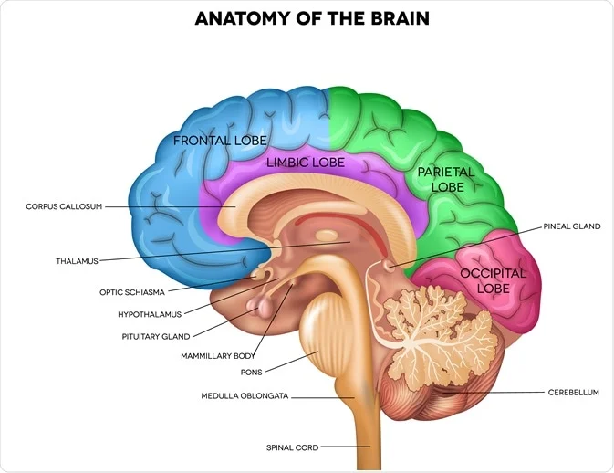
Introduction
Malignant (high-grade) vs Benign (low-grade)
Data from 1994 to 2018
Scotland and Regional Incidence
cases per 100,000 people per year
Survival rate
Image Credit: Tefi/Shutterstock.com

Slide 3
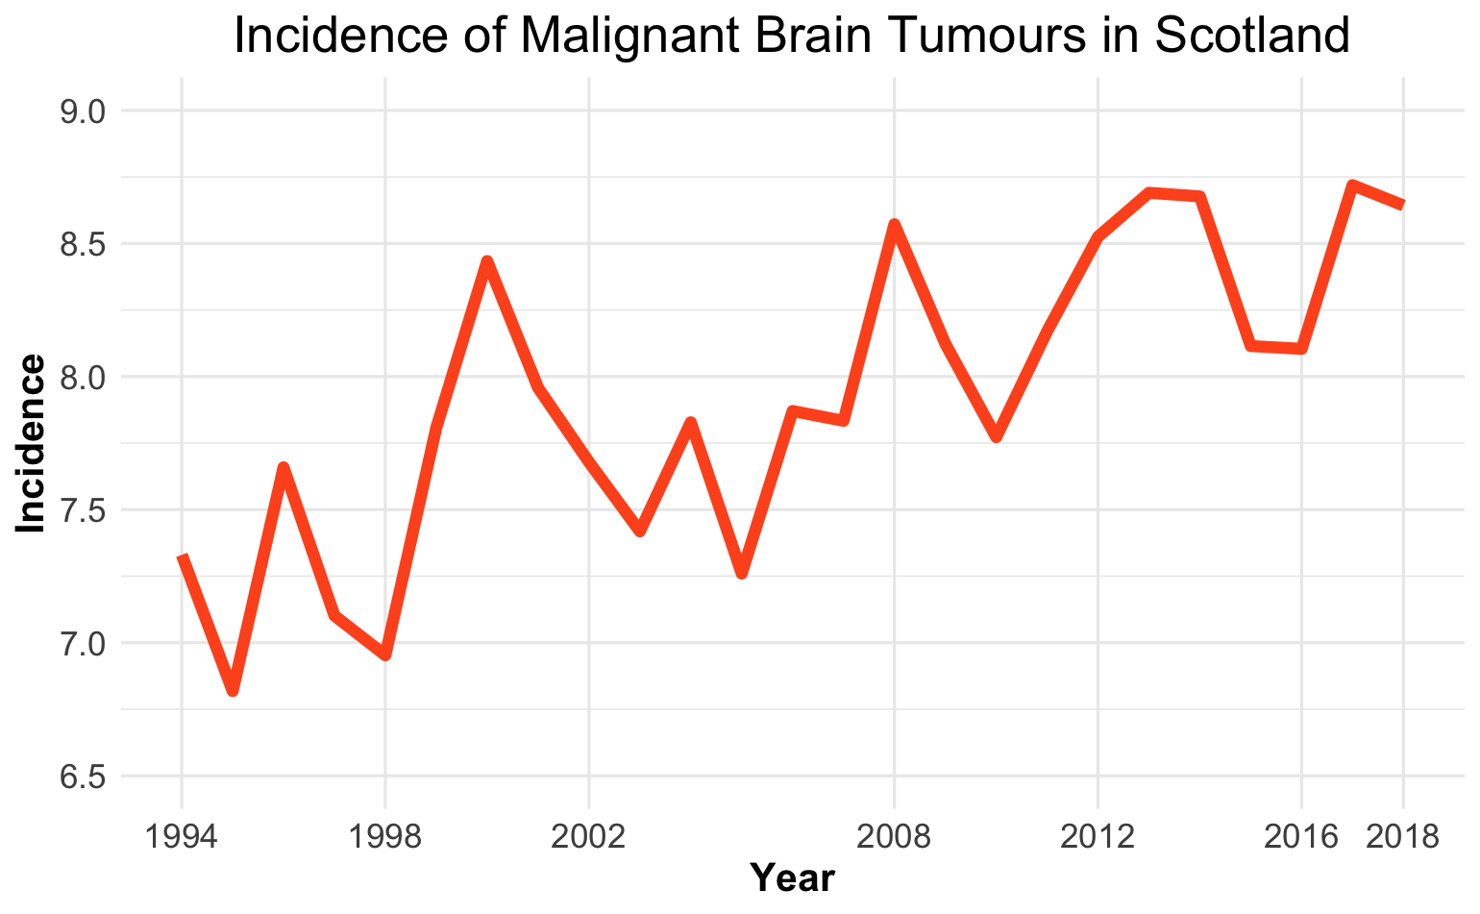
Incidence
In 2018 there were 470 malignant brain tumours
1.3 people diagnosed per day
In 1994 there were 374 malignant brain tumours
1 person diagnosed per day
In 2018 there were 496 benign brain tumours

Slide 4
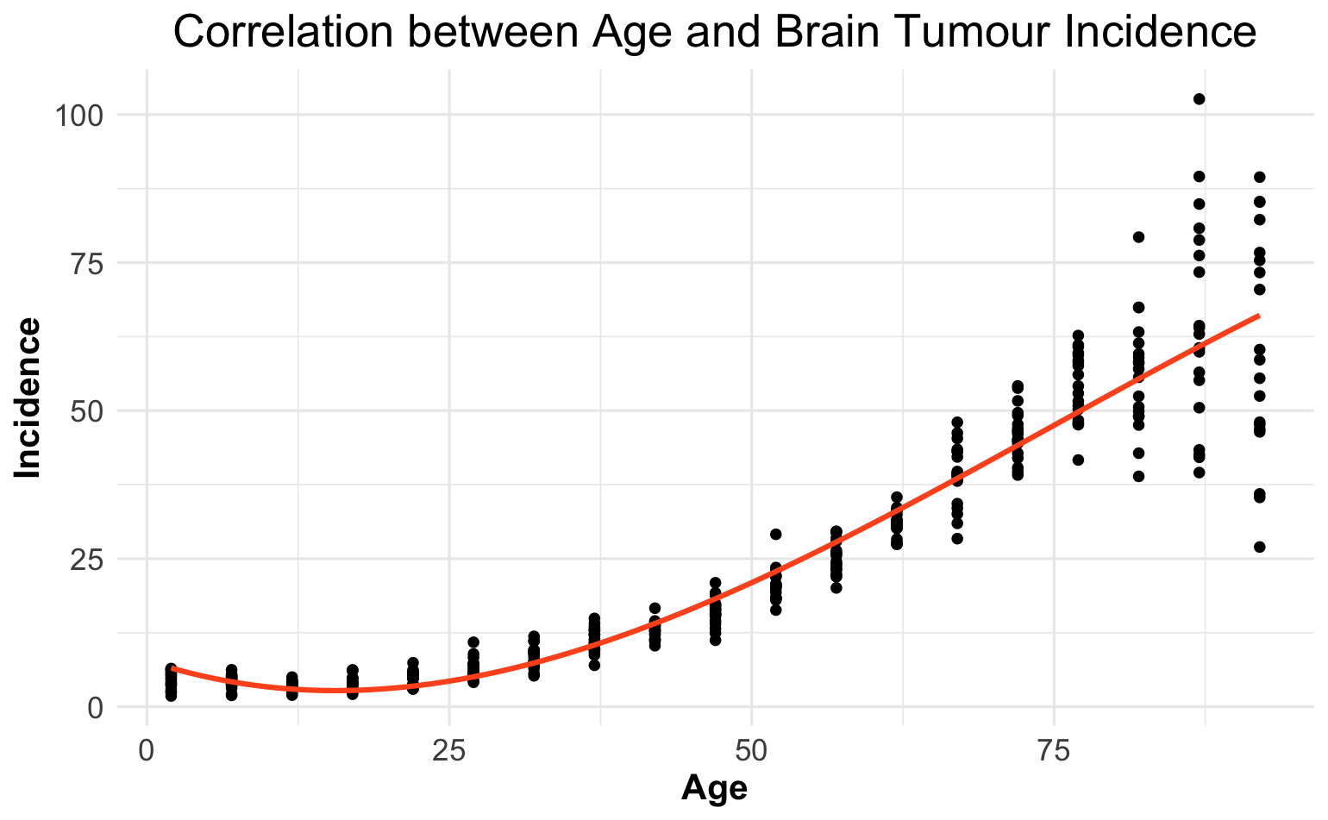
Why is this?
Risk Factors:
Age
Radiation
Family History
Obesity

Slide 5
Aging Population

Slide 6
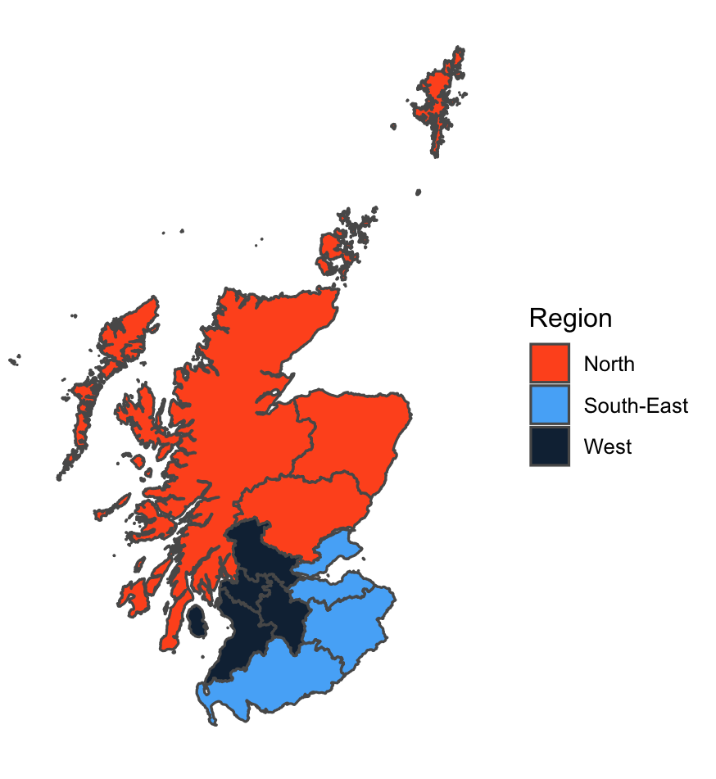
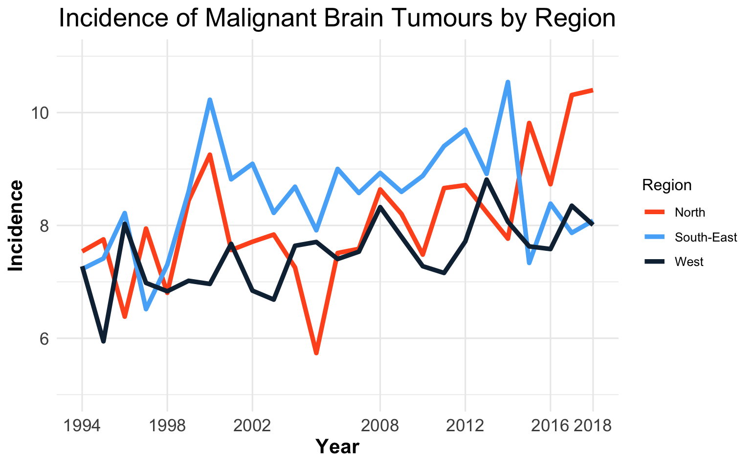
Regional Incidence

Slide 7
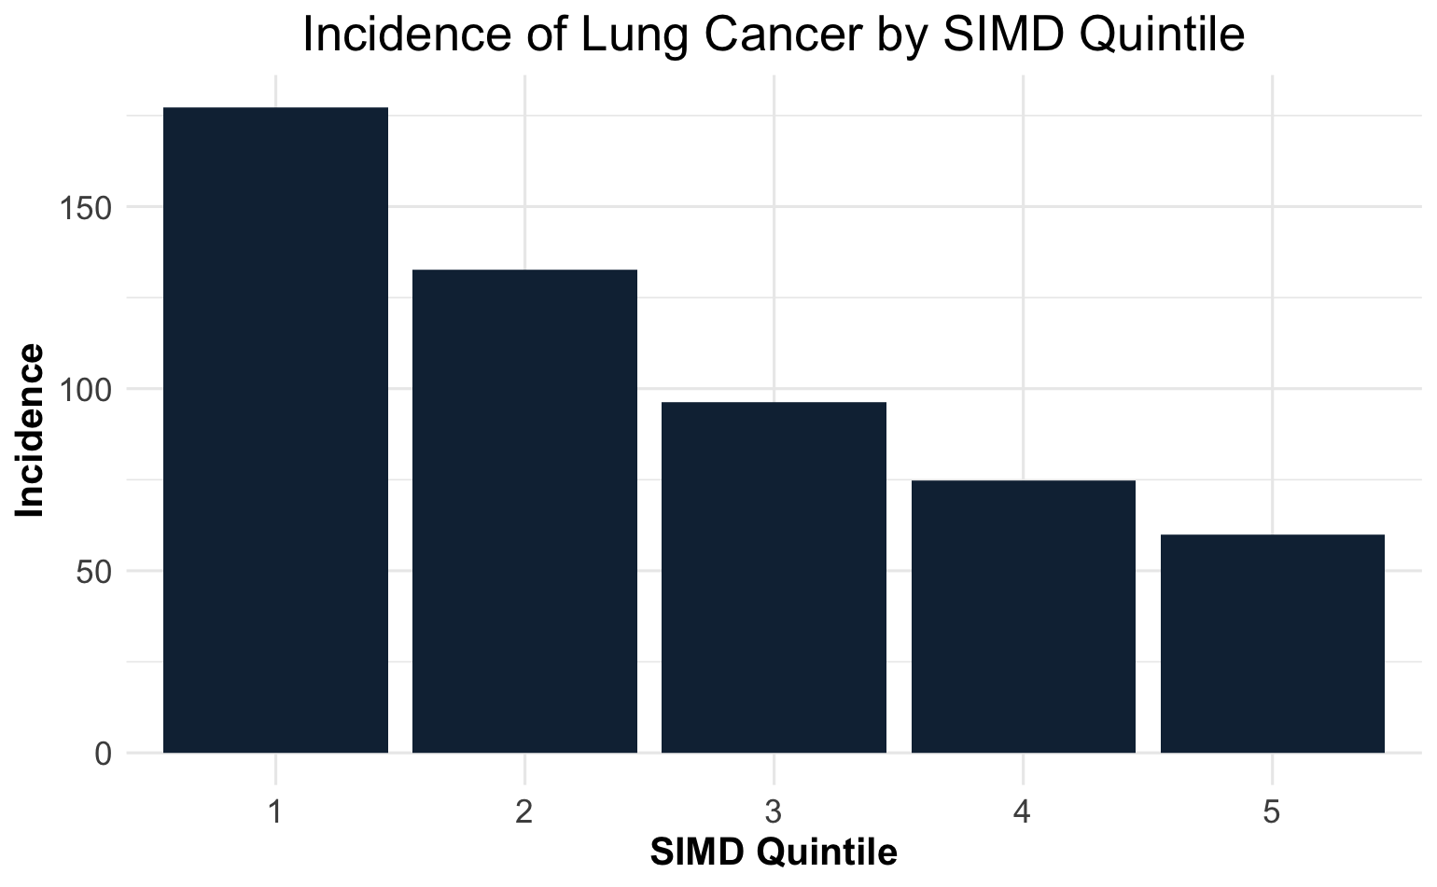
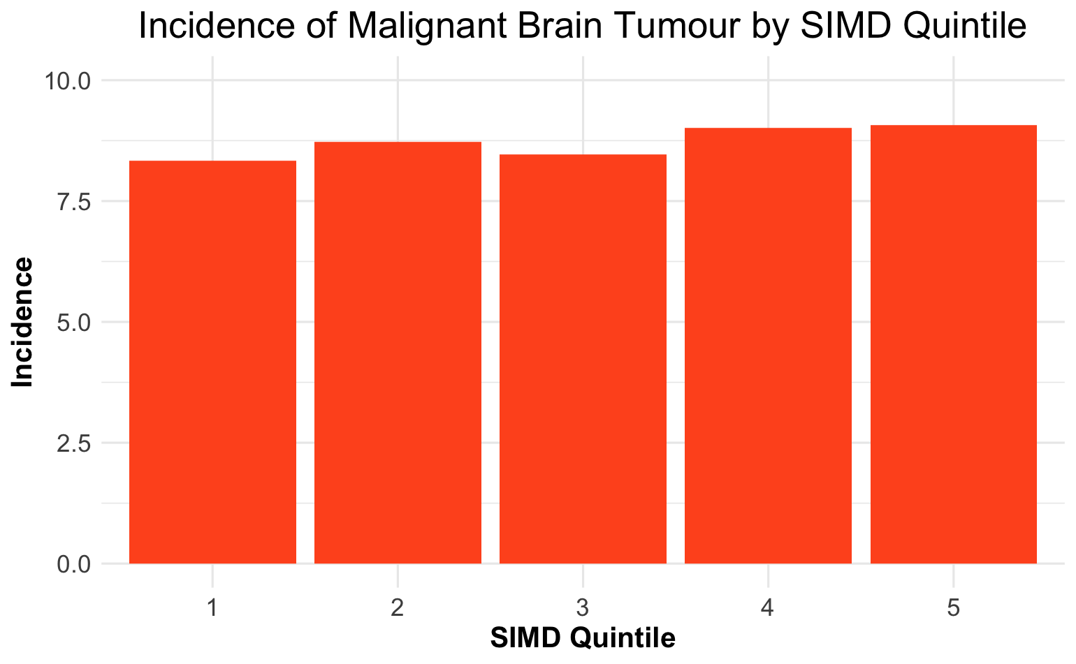
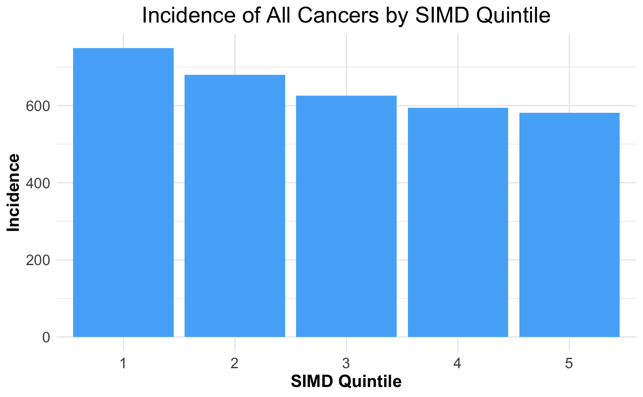
Deprivation
Scottish Index of Multiple Deprivation (SIMD)
1 = Most Deprived
5 = Least Deprived
Combined incidence rates from 2014-2018
European Age-sex Standardised Rate (EASR)

Slide 8
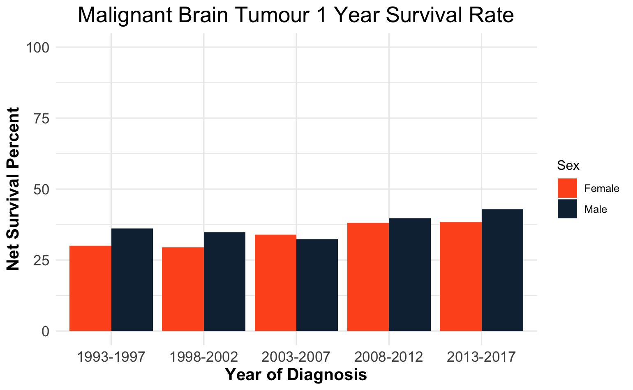
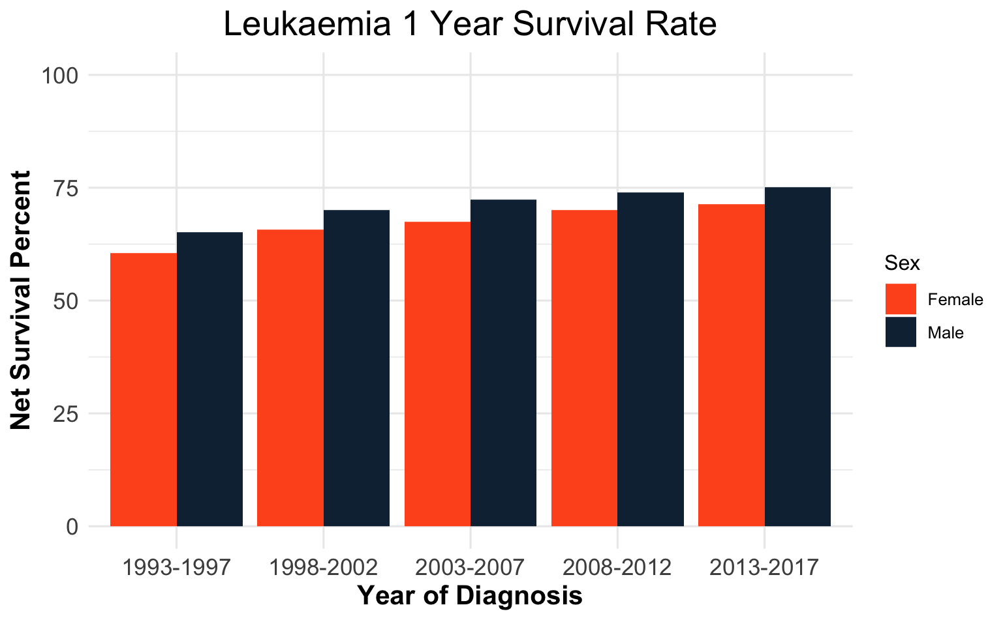
Survival Rates at 1 year

Slide 9
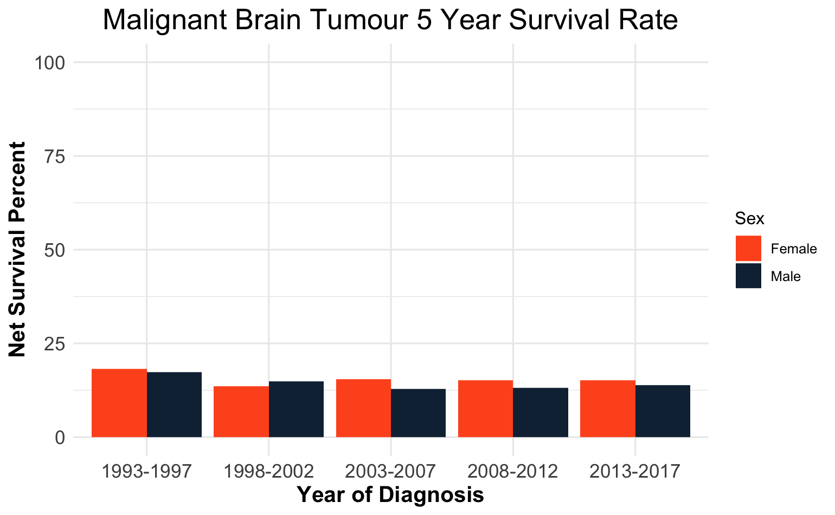
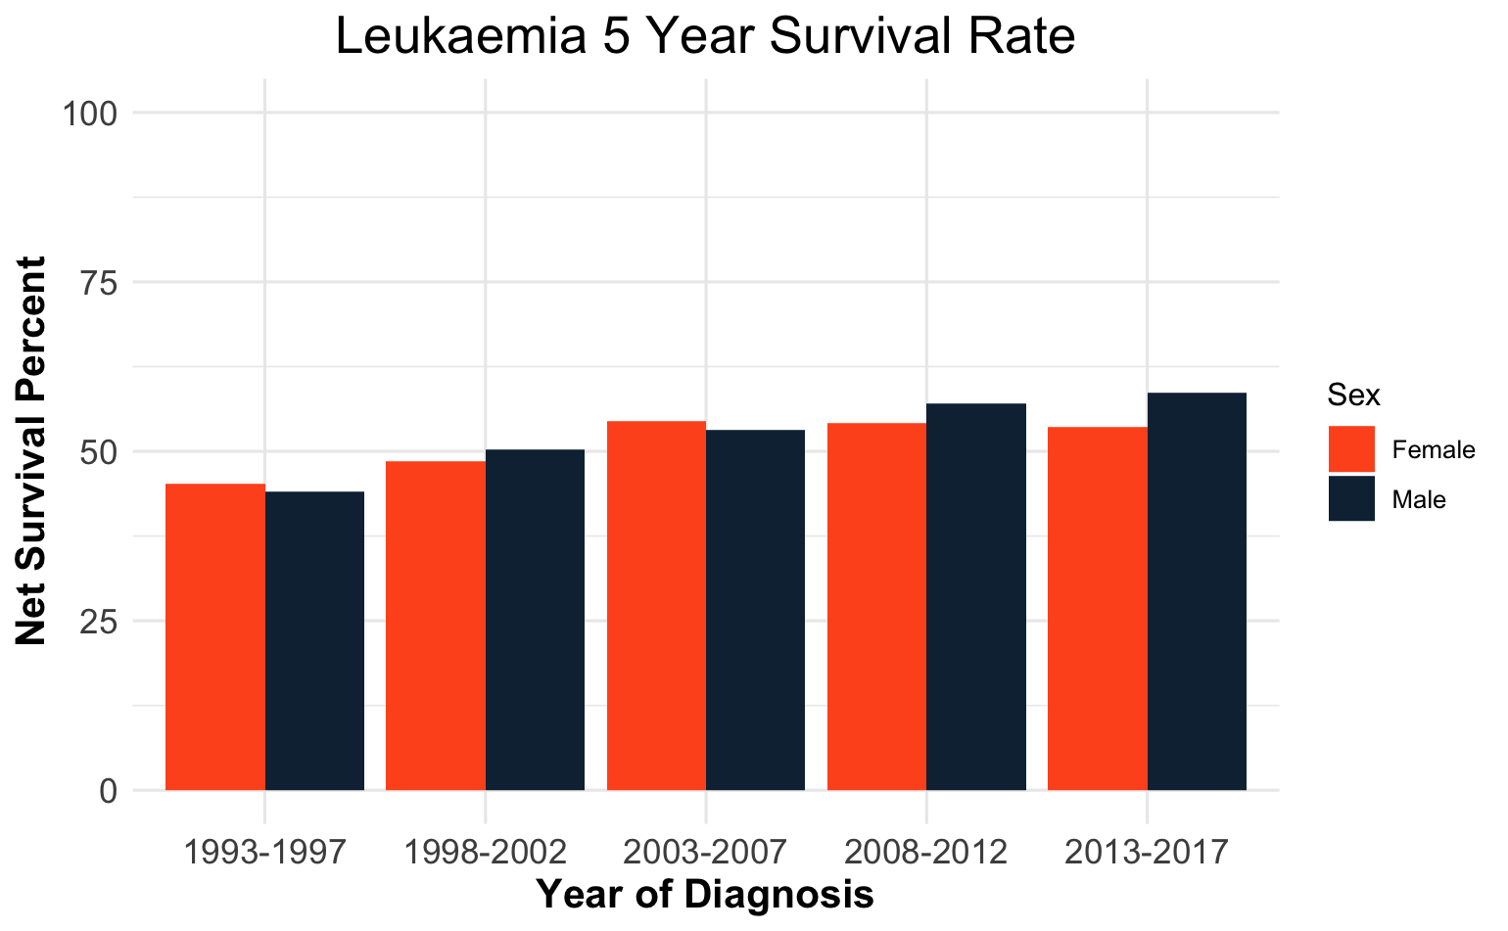
Survival Rates at 5 years

Slide 10
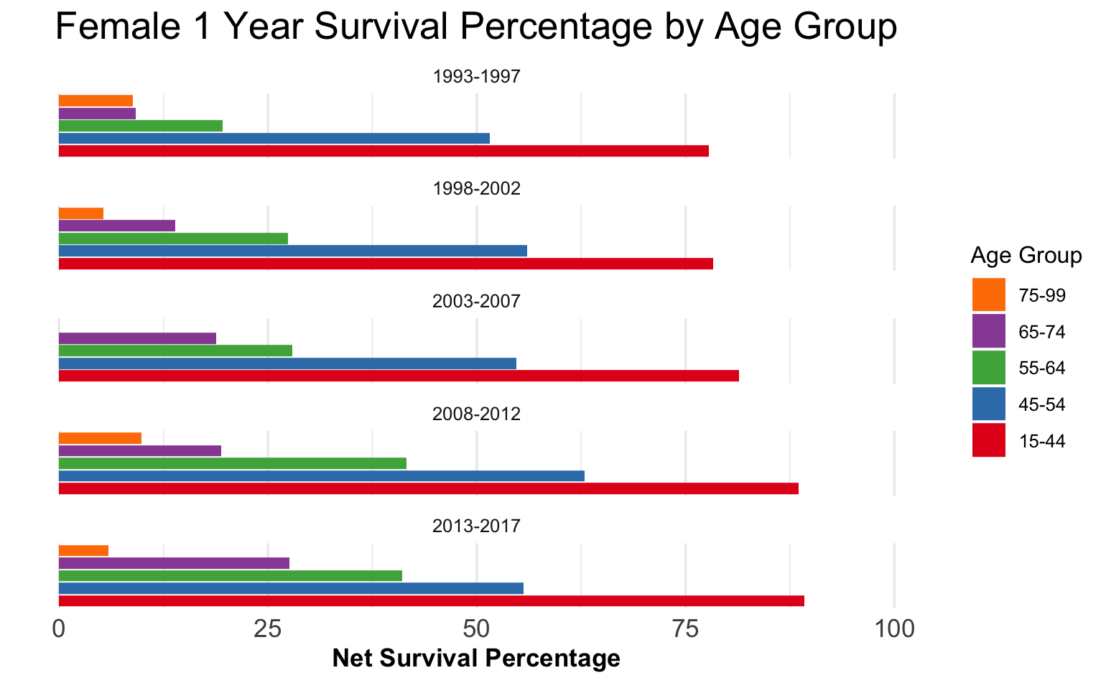
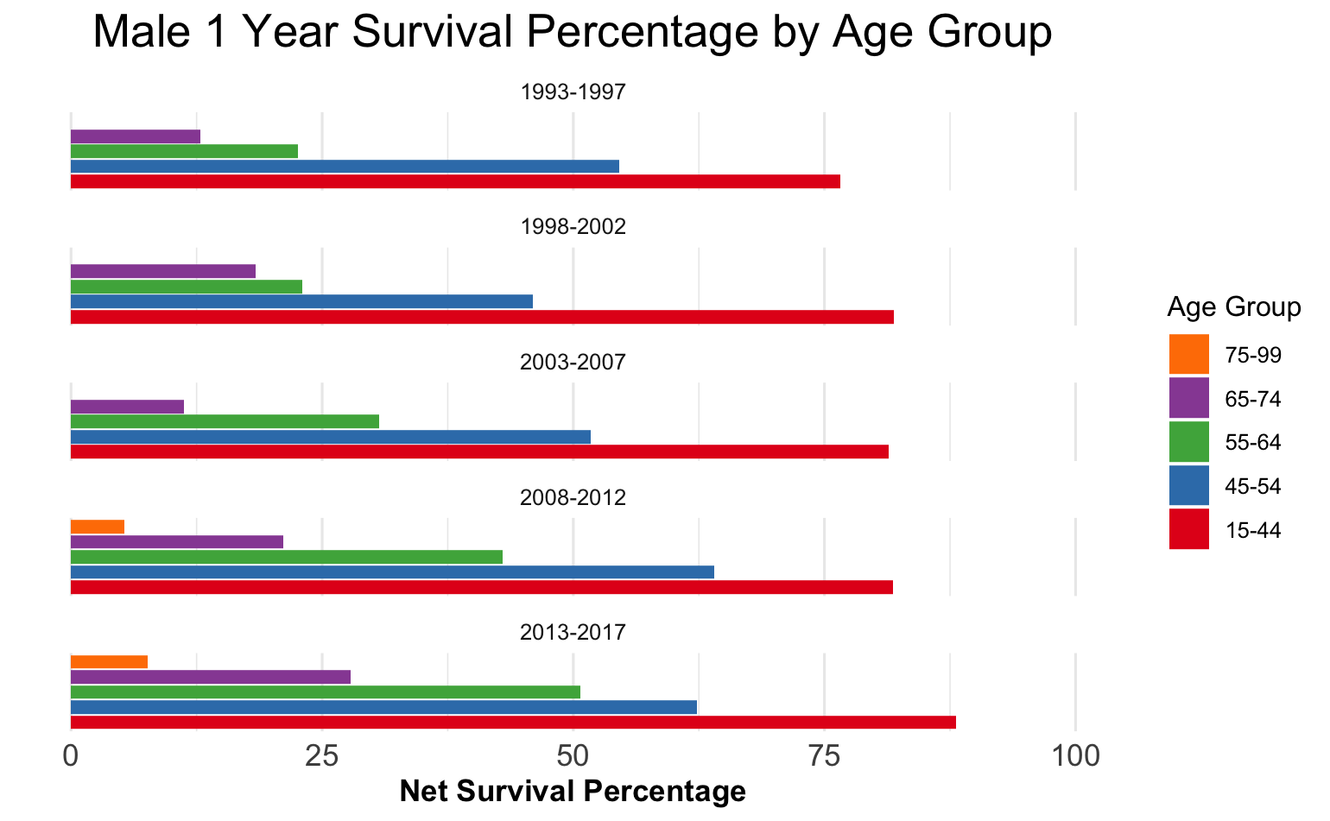
Survival by Age group

Slide 11
Difficulties
Benign tumour data not always reported
Small number of cases
Limited information on Risk Factors
No information on how patient’s present

Slide 12
Summary and Next Steps
Incidence is increasing as our population ages
Incidence is similar across health boards and SIMD quintiles
1 and 5 year survival rates are low and not improving
Request data for:
Symptoms and stage at presentation
Specific cancer type/site
Survival rates of non-malignant tumours
Before 1994 to estimate the impact of MRI’s
Monitor future survival rates as new treatments such as stereotactic laser ablation become more widely available throughout the UK.

Slide 13
Questions?

